Slide 1
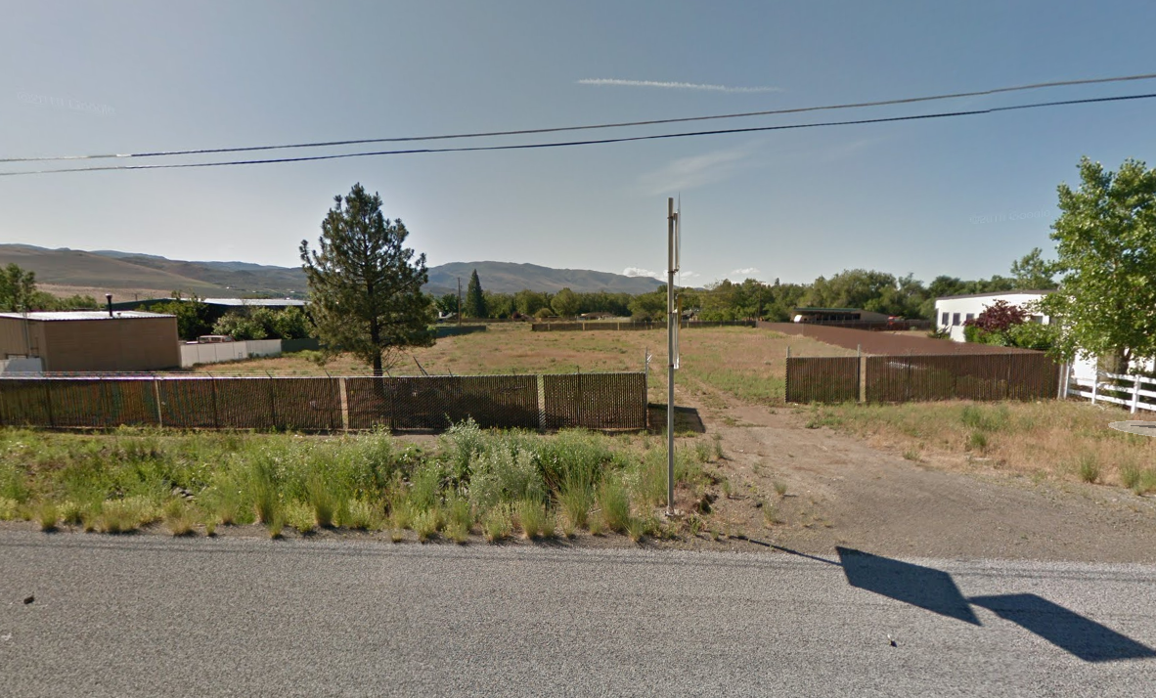
WSUP19-0023 DDC Enterprises
Washoe County Board of Adjustment
February 6, 2020

Slide 2
Background/Request
The applicant is requesting a special use permit to operate a construction sales and services office, with storage of operable vehicles within the Old Washoe City Historic CMA.
The applicant is also requesting to legalize the grading on the subject property.

Slide 3
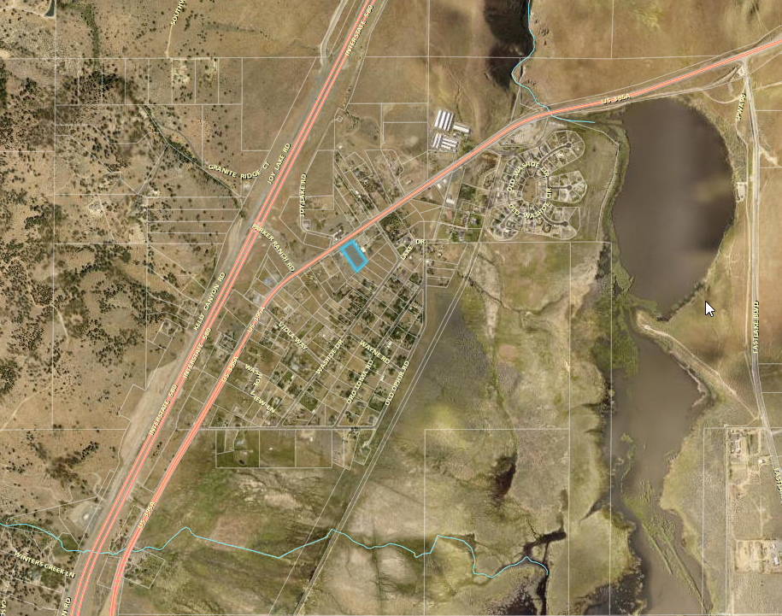
Vicinity Map

Slide 4
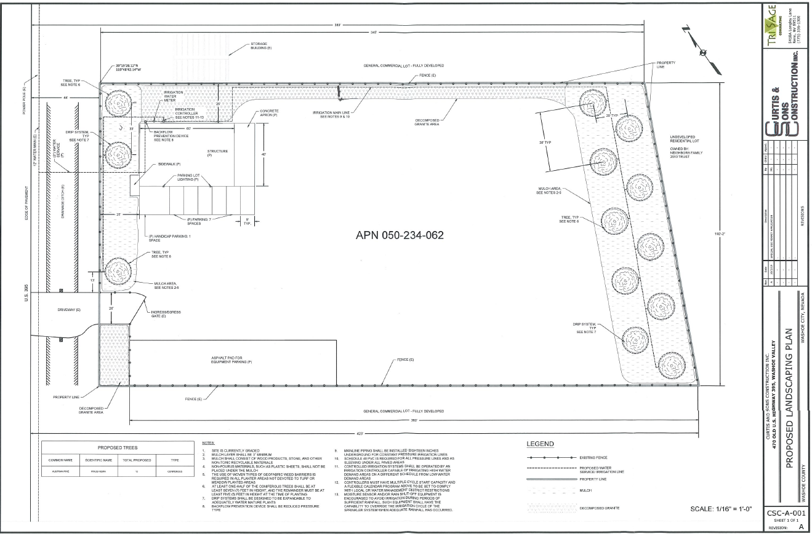
Landscape Plan

Slide 5
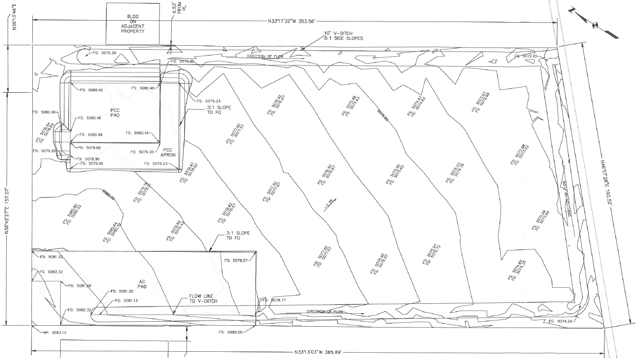
Grading Plan

Slide 6
Analysis
Property has a General Commercial regulatory zone
1.6 acres, currently vacant
Construction Sales and Services use type
Storage of Operable Vehicles use type

Slide 7
Analysis
Illegal grading occurred on property
1.6 acres graded
V-ditches constructed on the east and west property lines for drainage. Includes 6:1 side slopes.
Original slope was 3%
The total amount of grading for this property is estimated to be 1,138cy (cubic yards) of cut, 1,511cy of fill, and 13cy of import.

Slide 8
South Truckee Meadows / Washoe Valley CAB
Meeting January 2, 2020
Concerns related to the following:
  Landscaping
  Hours of Operation
  Traffic Numbers
South Truckee Meadows/Washoe Valley Citizen Advisory Board unanimously recommend approval of the proposed kennel and associated uses.

Slide 9
Findings
1. Consistency. That the proposed use is consistent with the action programs, policies, standards and maps of the Master Plan and the Spanish Springs Area Plan;
2. Improvements. That adequate utilities, roadway improvements, sanitation, water supply, drainage, and other necessary facilities have been provided, the proposed improvements are properly related to existing and proposed roadways, and an adequate public facilities determination has been made in accordance with Division Seven;
3. Site Suitability. That the site is physically suitable for a commercial kennel and contractors office, and for the intensity of such a development;
4. Issuance Not Detrimental. That issuance of the permit will not be significantly detrimental to the public health, safety or welfare; injurious to the property or improvements of adjacent properties; or detrimental to the character of the surrounding area;
5. Effect on a Military Installation. Issuance of the permit will not have a detrimental effect on the location, purpose or mission of the military installation.

Slide 10
Recommendation
After a thorough analysis and review, Special Use Permit Case Number WSUP19-0023 is being recommended for approval with conditions. Staff offers the following motion for the Commission’s consideration.

Slide 11
Possible Motion
I move that, after giving reasoned consideration to the information contained in the staff report and information received during the public hearing, the Washoe County Board of Adjustment with conditions Special Use Permit Case Number WSUP19-0023 for DDC Enterprises, having made all five findings in accordance with Washoe County Code Section 110.810.30.

